Slide 1


Deep Learning-Based Approach for Automated Biometric Identification of Mugger
Crocodiles
CSE641 Computer Vision: Modern Methods and Applications
Group 5: Shalvi Modi, Daksh Shah, Sloka Thakkar

Slide 2
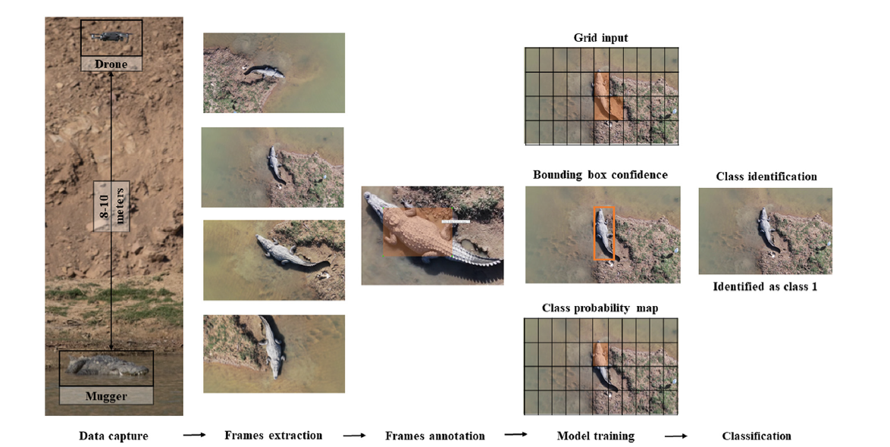

Problem Statement
Using a deep learning approach to automate the biometric identification of Mugger crocodiles, improve accuracy, and analyze the impact of new seasonal data on the model's performance.
Fig.1 [3] Class Identification Flow Chart
[3]Ghosal, Ratna & Shah, Supan & Patel, Arpit & Patel, Vaishwi & Raval, Mehul & Desai, Brinky. (2022). Identification of free-ranging mugger crocodiles by applying deep learning methods on UAV imagery. 10.5061/dryad.s4mw6m98n.

Slide 3
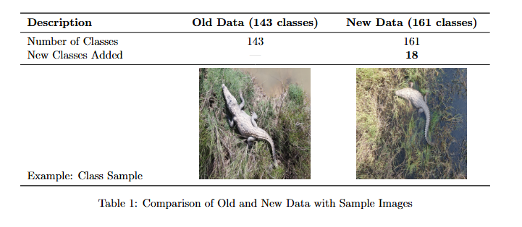
Feedback received
To measure inference time for mugger detection in deep learning approach
Comparison of the results obtained from the deep learning approach with the machine learning approach
Incorporation of the new season data and obtain the results.
Fig 2 .New Data Description

Slide 4
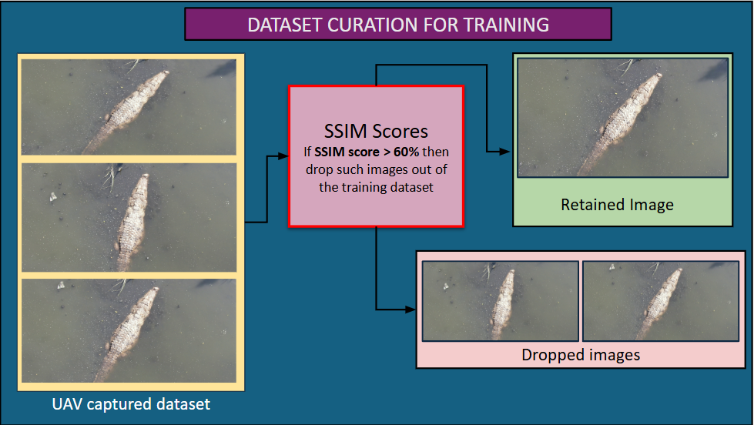
Methodology

Slide 5
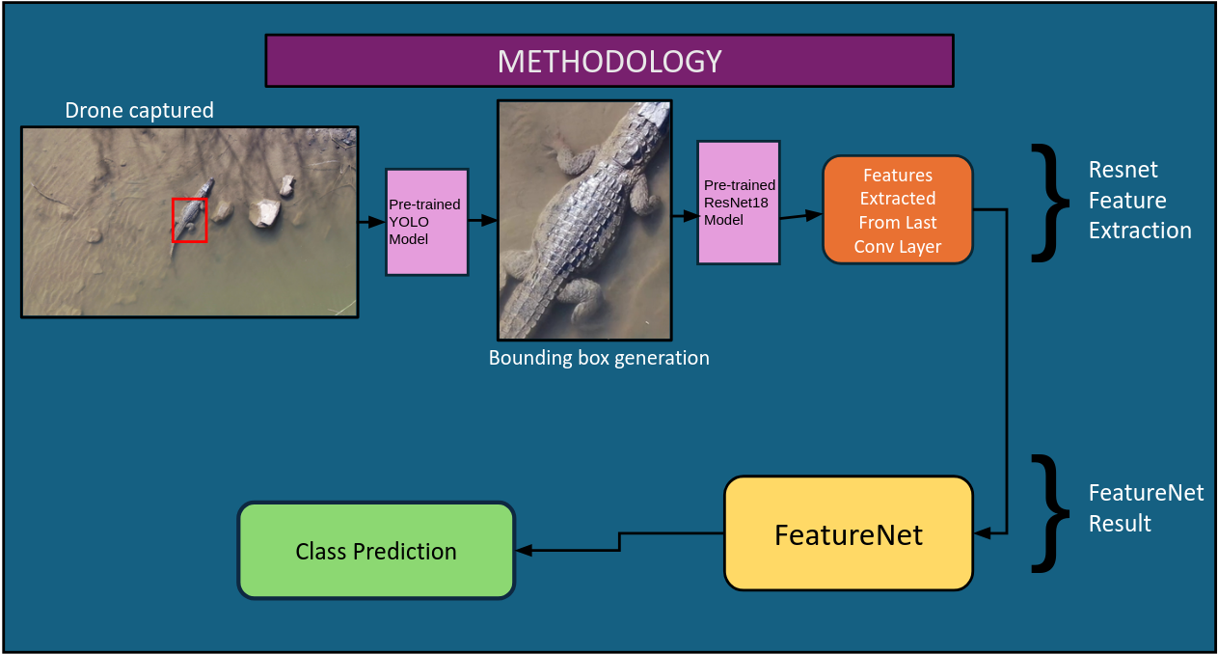
Methodology

Slide 6
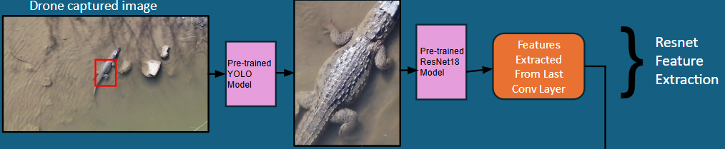
Methodology
UAV captured images are passed through a pre-trained YOLO model detects the bounding box for the mugger crocodile. The detected image is then processed through a pretrained ResNet 18 model, where features are extracted from the last convolutional layer for identification and analysis.

Slide 7
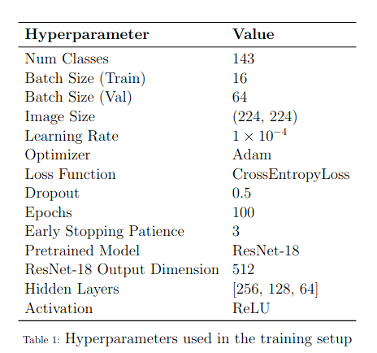

Methodology
A test image is passed through a trained model, which utilizes the extracted features from the last convolutional layer. These features are further processed by FeatureNet, which generates the feature representation. The trained model then uses these processed features to predict the class of the image.

Slide 8
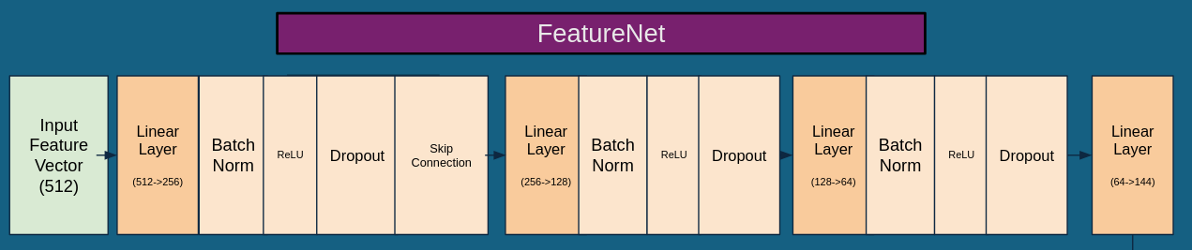
Methodology
FeatureNet processes an input feature vector of 512 dimensions through a series of fully connected (linear) layers with progressively decreasing dimensions: 512 → 256 → 128 → 64 → 144. Each linear layer is followed by batch normalization, ReLU activation, and dropout to enhance generalization and stability. A skip connection is introduced after the first linear transformation (512 → 256) to preserve important features and improve gradient flow. The final linear layer (64 → 144) produces the processed feature representation, which can be used for classification.

Slide 9
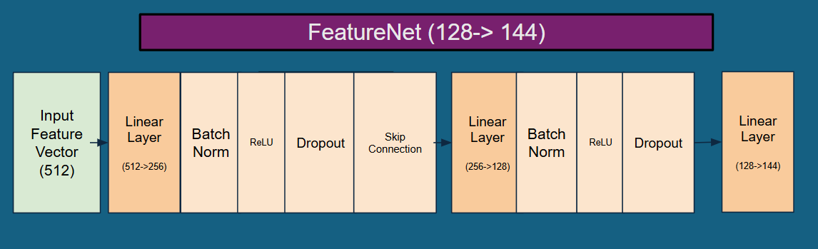
Methodology
FeatureNet processes an input feature vector of 512 dimensions through a series of fully connected (linear) layers with progressively decreasing dimensions: 512 → 256 → 128 → 64 → 144. Each linear layer is followed by batch normalization, ReLU activation, and dropout to enhance generalization and stability. A skip connection is introduced after the first linear transformation (512 → 256) to preserve important features and improve gradient flow. The final linear layer (128 → 144) produces the processed feature representation, which can be used for classification.

Slide 10
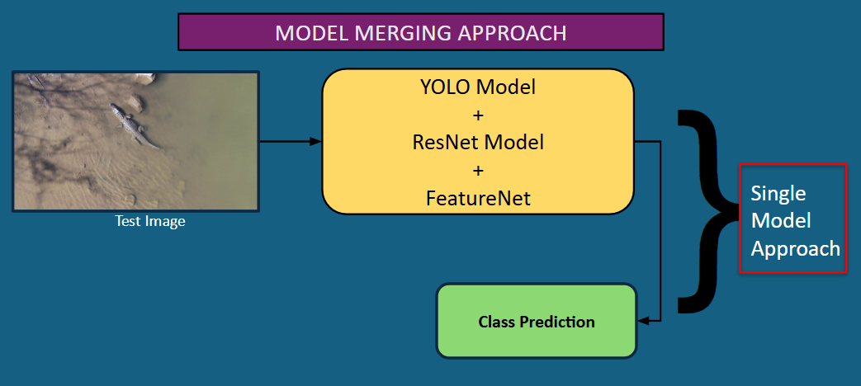
Methodology

Slide 11
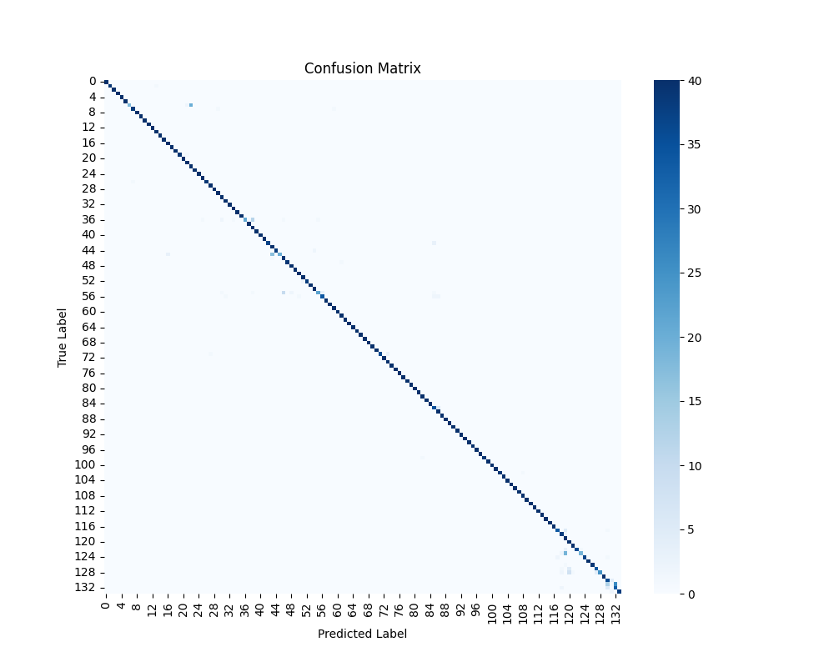
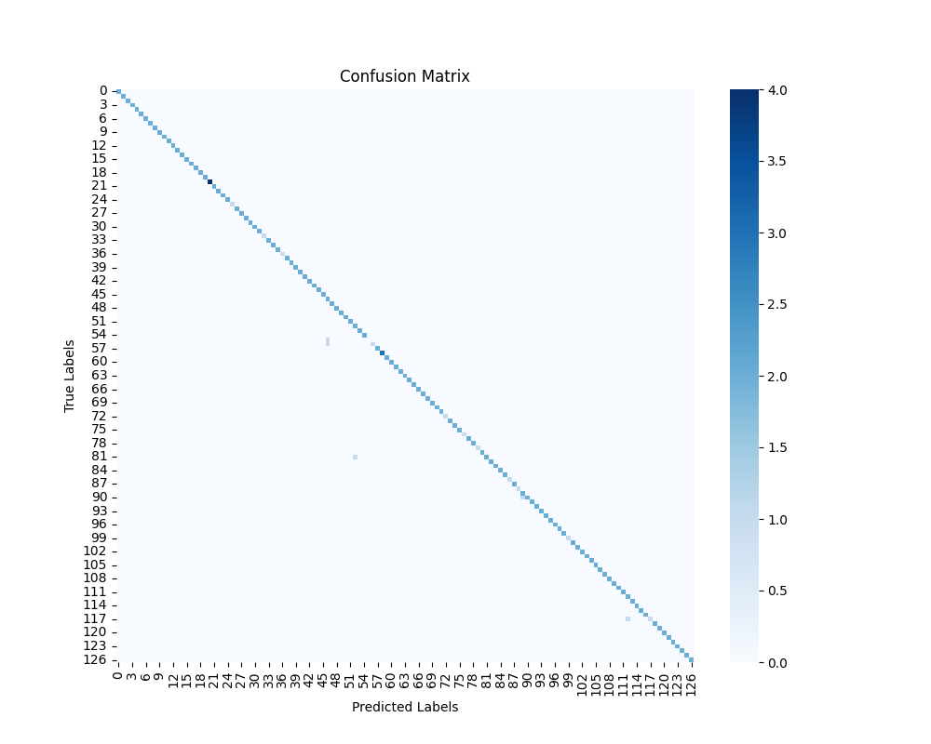
Results (FeatureNet 64->144)
Fig 3 .Confusion Matrix Train Data
Fig 4 .Confusion Matrix Test Data

Slide 12
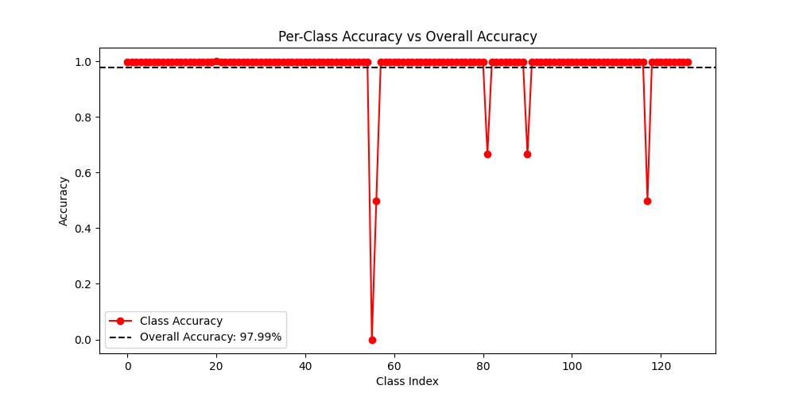
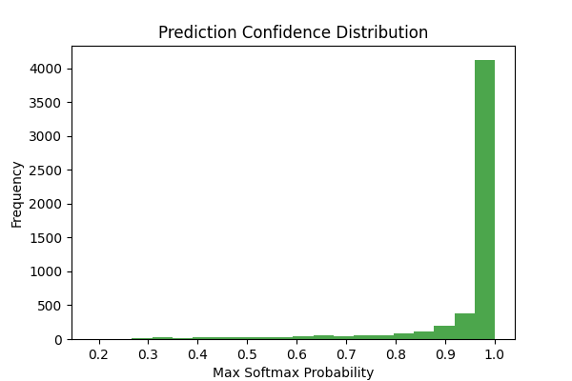
Results (FeatureNet 64->144)
Fig 5.Per Class Accuracy vs Overall Accuracy
Fig 6.Prediction Confidence Distribution

Slide 13
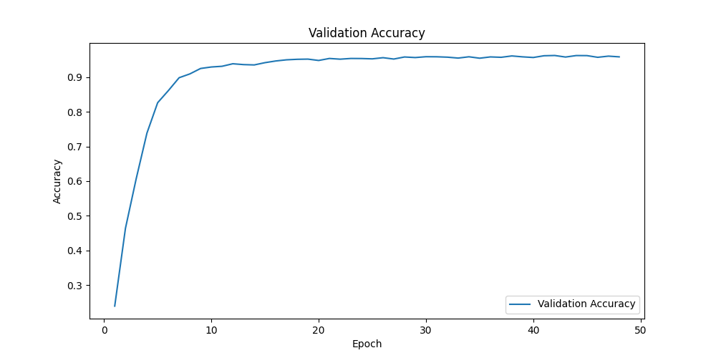
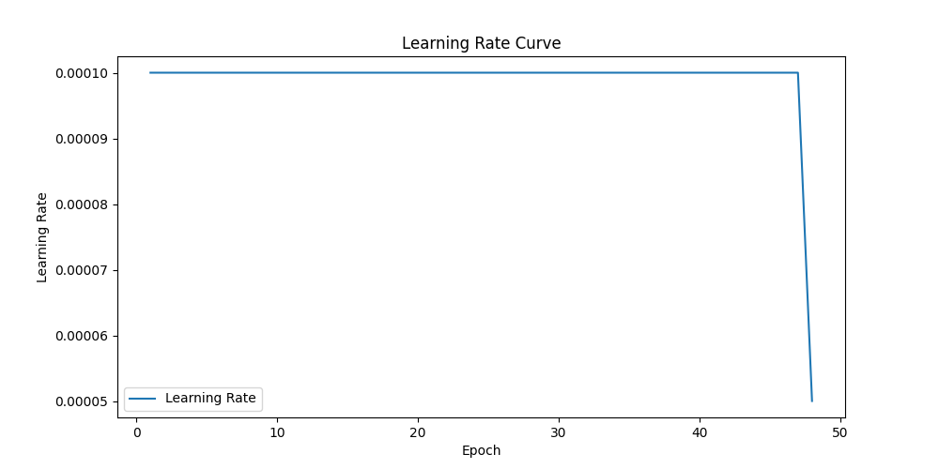
Results (FeatureNet 64->144)
Fig 7.Validation Accuracy
Fig 8 .Learning Rate Curve

Slide 14
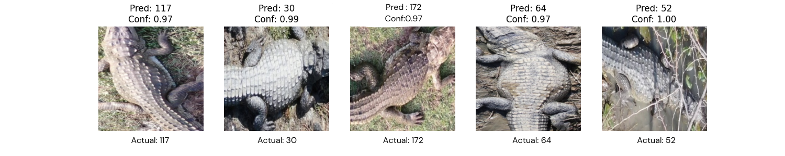
Results (FeatureNet 64->144)
This is the output when a test image is passed in the trained model. The class of the Mugger crocodile is predicted along with the confidence score. The confidence score indicates how much confidence the model has in its predictions.

Slide 15


Results (FeatureNet 128->144)
Fig 9 .Confusion Matrix Train Data
Fig 10 .Confusion Matrix Test Data

Slide 16
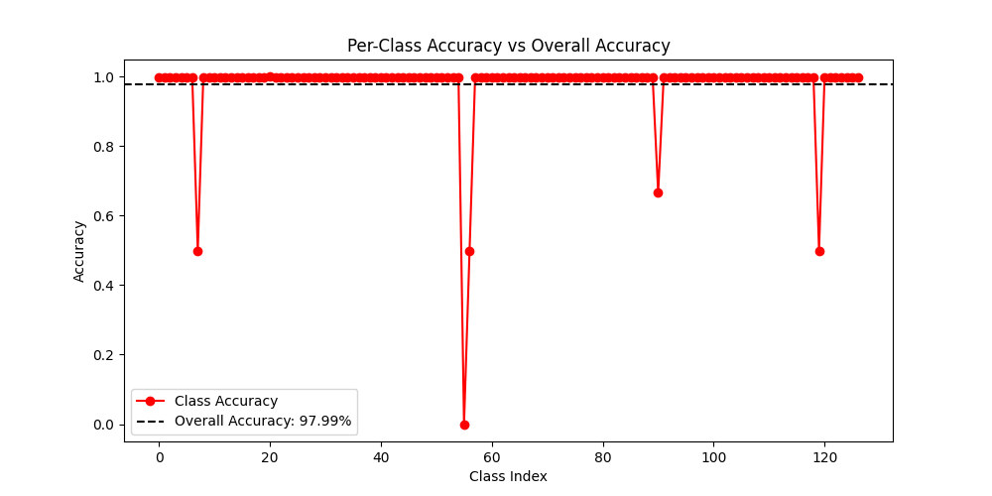
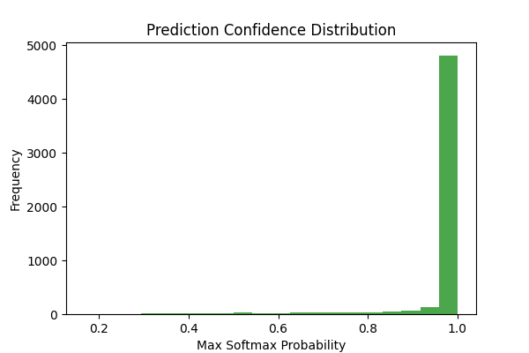
Results (FeatureNet 128->144)
Fig 11 .Per Class Accuracy vs Overall Accuracy
Fig 12 .Prediction Confidence Distribution

Slide 17
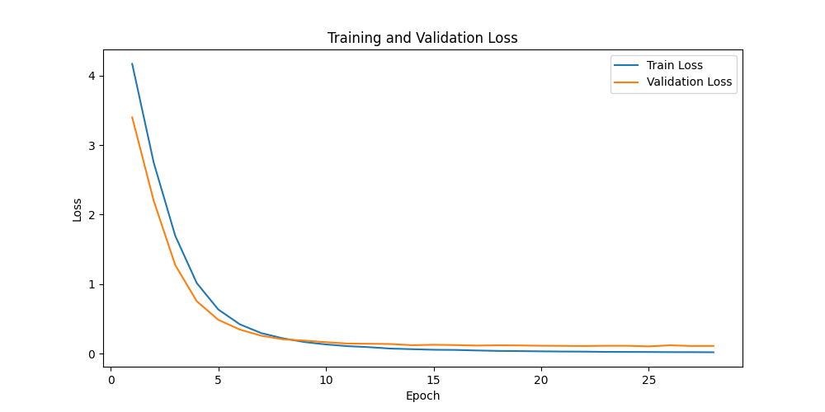
Results (FeatureNet 128->144)
Fig 13.Training and Validation Loss

Slide 18
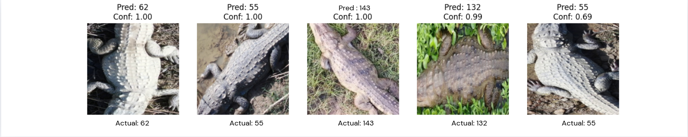
Results (FeatureNet 128->144)
This is the output when a test image is passed in the trained model. The class of the Mugger crocodile is predicted along with the confidence score. The confidence score indicates how much confidence the model has in its predictions.

Slide 19
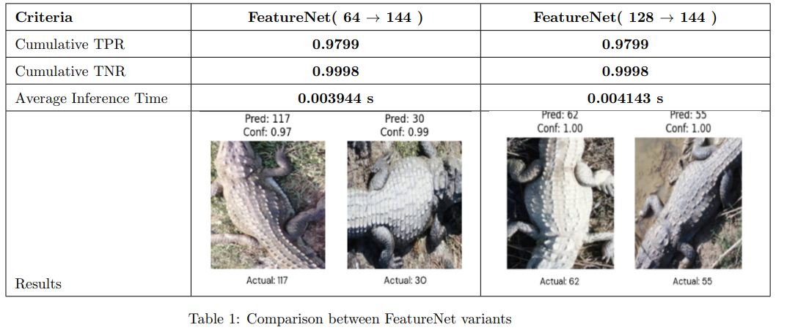
Comparison of Architecture

Slide 20
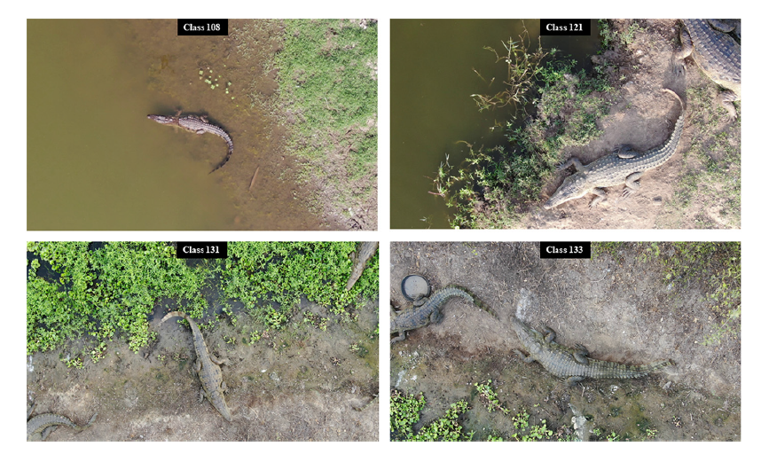
Future Scope
Future work can replace YOLO v11-based bounding box detection with advanced image segmentation methods, enabling more precise localization and improved accuracy in classical machine learning-based mugger identification . Moreover the future work also involves system deployment.
Fig.14 [3]

Slide 21
References
[1]Kokal, S., Vanamala, M., & Dave, R. (2023). Deep Learning and Machine Learning, Better Together Than Apart: A Review on Biometrics Mobile Authentication. Journal of Cybersecurity and Privacy, 3(2), 227-258. https://doi.org/10.3390/jcp3020013
[2]Al-Waisy, A.S., Qahwaji, R., Ipson, S. et al. A multi-biometric iris recognition system based on a deep learning approach. Pattern Anal Applic 21, 783–802 (2018). https://doi.org/10.1007/s10044-017-0656-1
[3]Ghosal, Ratna & Shah, Supan & Patel, Arpit & Patel, Vaishwi & Raval, Mehul & Desai, Brinky. (2022). Identification of free-ranging mugger crocodiles by applying deep learning methods on UAV imagery. 10.5061/dryad.s4mw6m98n.
[4]Alexandre Delplanque, Samuel Foucher, Jérôme Théau, Elsa Bussière, Cédric Vermeulen, Philippe Lejeune,From crowd to herd counting: How to precisely detect and count African mammals using aerial imagery and deep learning?,ISPRS Journal of Photogrammetry and Remote Sensing,
[5]Moreni, M., Theau, J., & Foucher, S. (n.d.). Do you get what you see? insights of using map to select architectures of pretrained neural networks for automated aerial animal detection. PLOS ONE. https://journals.plos.org/plosone/article?id=10.1371%2Fjournal.pone.0284449
[6]Multispecies detection and identification of African mammals in aerial imagery using convolutional neural networks - Delplanque - 2022 - remote sensing in ecology and Conservation - Wiley Online Library. (n.d.). https://zslpublications.onlinelibrary.wiley.com/doi/10.1002/rse2.234

